Slide 1
Broadcast Technology UG1
5: The Legacy of Analogue
Jerry Foss
jeremy.foss@bcu.ac.uk

Slide 2
History

Slide 3
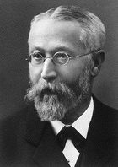
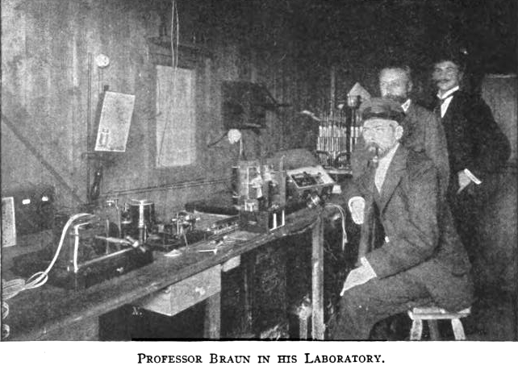
History - Ferdinand Braun - CRT
Ferdinand Braun:
1890 - developed the Cathode Ray Tube (CRT)
1897 - developed the Cathode Ray Oscillograph
… the precursor to the radar screen and the television tube
1907 - First use of cathode ray tube to produce the rudiments of television images
1909 - shared the Nobel Prize for physics in 1909 with Guglielmo Marconi for his contributions to the development of wireless telegraphy

Slide 4
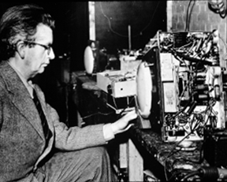
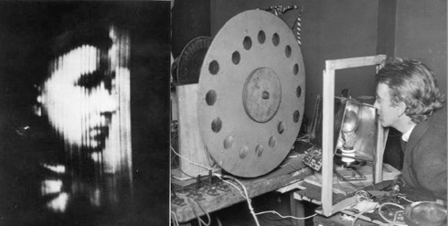

John Logie Baird - Basic TV
Oct 1923 - the first person in the world to demonstrate true television, recognisable images, instantaneous movement, correct gradations in light and shade
Scanning was done mechanically with a Nipkow disc. The first 30 line picture transmitted was a Maltese cross
1927 demonstrated video recording
1928 transatlantic television
1937 broadcast of good definition colour pictures
1941 stereoscopic television in colour
1944 multi-gun colour television tube
Baird’s televisor, 1925: before transmission, the received image at left has been scanned by a spiral of revolving lenses, shown at right with inventor Logie Baird. Photo: Hulton/Getty
left – early tests were with this ventriloquist’s dummy

Slide 5
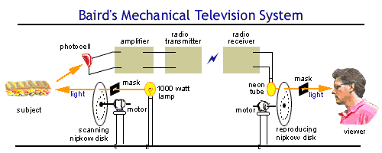
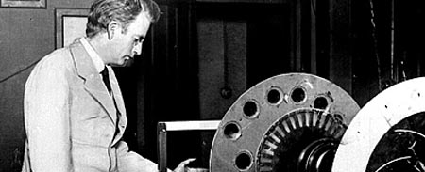
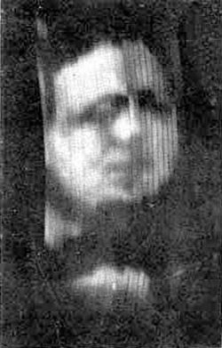
30 Line Mechanical TV

Slide 6
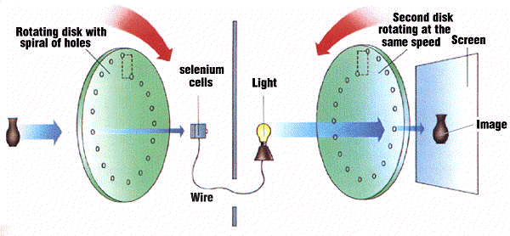
Early Mechanical Approach to TV
Mechanical Nipkow discs were used to scan the image and reconstitute the image at the receiver. PE cells were used to capture the image. The problem was synchronising the disks.

Slide 7
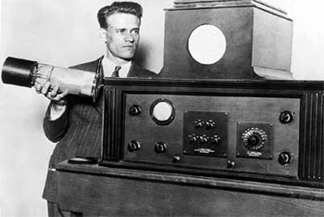
Electronic Television - Farnsworth
Philo Farnsworth
1922 (at Age 14) concepts of Electronic Television
Demonstration, Sept 1927:
painted a square of glass black and scratched a straight line on the centre
The slide was dropped between the Image Dissector (camera tube Farnsworth invented earlier that year) and a hot, bright, carbon arc lamp.
receiver - saw the straight-line image
as the slide was turned 90 degrees, image moved
the first all-electronic television picture ever transmitted.

Slide 8
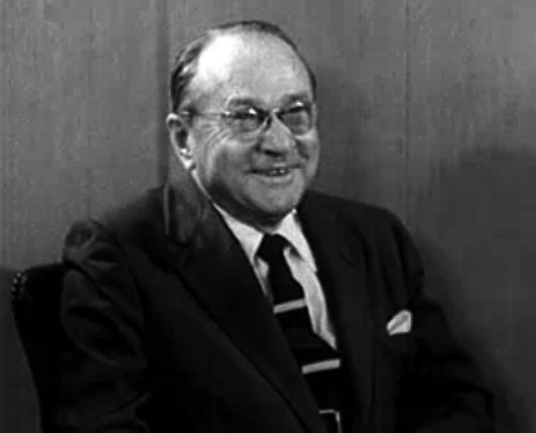
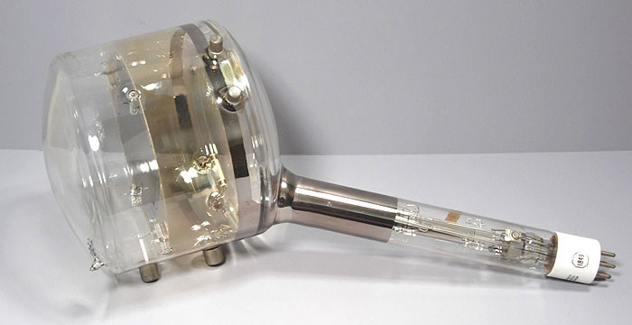
Vladimir Zworykin - Iconoscope
Vladimir Zworykin of RCA
1923 - patent application for a camera device
1933 - developed a camera tube he called an Iconoscope
Zworykin submitted his patent application first …
… but after many years of legal battle Farnsworth was acknowledged as the inventor of electronic television.
end 1923 - he produced a picture display tube, the "Kinescope”

Slide 9
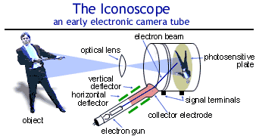
Vladimir Zworykin - Iconoscope

Slide 10
Analogue TV Technology
mostly history
but many elements remain in digital systems

Slide 11
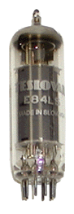

Thermionic Valves
Anode
Vacuum
Cathode
Heater
Heater Circuit

Slide 12
Thermionic Valves
Anode
Electrons released from cathode due to heating
Cathode
Heater
Heater Circuit

Slide 13
Thermionic Valves
Anode
Electrons attracted to Anode
Cathode
Heater
Heater Circuit

Slide 14
Thermionic Valves
Current flow
(is opposite to electron movement)
Anode
Electrons attracted to Anode
Cathode
Heater
Heater Circuit

Slide 15
Thermionic Valves - Triode
Electrons carry on to end of tube
Anode – attracts electrons, which pass straight through

Slide 16
Basic Amplification Circuits
A current flows through the valve
This is initially set up as a “quiescent condition” by circuitry
circuit bias
The (large) anode-cathode current can be varied by a small voltage applied to the grid
grid voltage varies as the signal input
output taken from anode
i.e. a small varying input voltage will cause much larger variations in the current flowing through the valve
hence … amplification
Simple Triode (amplifies)
Anode
current direction
Grid
low level input signal
Cathode
Heater
Heater Circuit

Slide 17
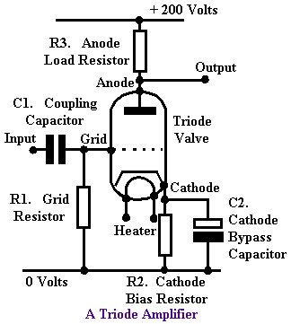
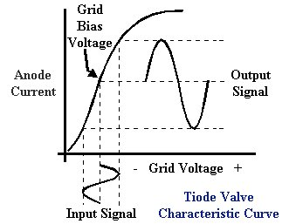
Basic Amplification Circuits
Simple Triode (amplifies)
Circuit components set up working conditions for valve operation
e.g. R3 allows O/P to be taken from anode, other wise O/P would be directly connected to the power supply (!)
similarly R1 allows I/P to grid, which also needs to be allied to the 0v supply
(also note the large power supply voltage)

Slide 18
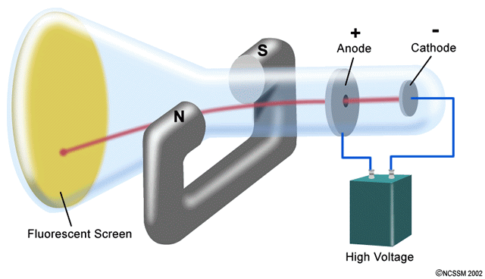
Cathode Ray Tube - CRT
Fleming’s LH rule indicates the field/current/deflection
N
electrons
current
S
Tube consists of a valve:
the cathode emits electrons (“cathode ray”)
electrons are negative charges
attracted to anode
shoot through anode
can be deflected by a magnetic field ...
www.dlt.ncssm.edu/TIGER/chem1.htm

Slide 19
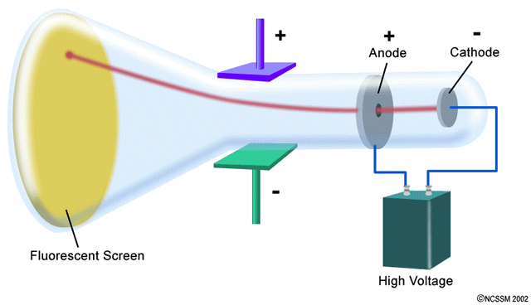
Cathode Ray Tube - CRT
electron beam could be guided by charged plates ...
The flourescent screen is a coating of phosphor dots which glow when the beam hits them
There are three beams: Red, Blue and Green, to produce RBG pixels on the screen (see later for more details)
www.dlt.ncssm.edu/TIGER/chem1.htm

Slide 20
Cathode Ray Tube - CRT
actually …
magnetic fields produced by electromagnetic coils
Two sets of coils apply appropriate magnetic field alignments to steer the beam vertically and horizontally across the screen
Voltage to control the coils are derived from the received TV signal
www.dlt.ncssm.edu/TIGER/chem1.htm

Slide 21
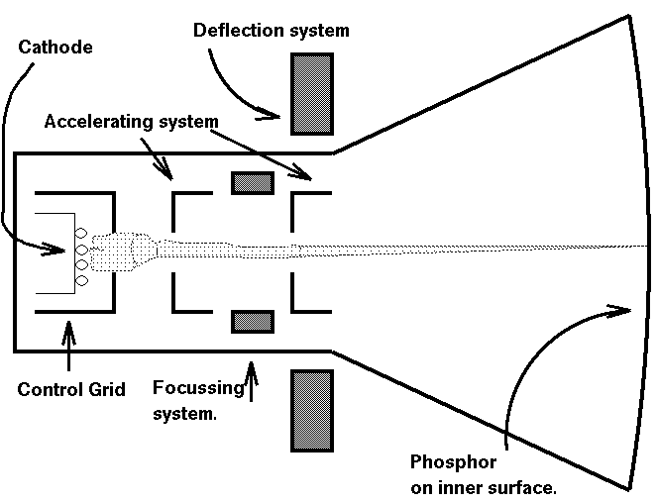
Cathode Ray Tube - CRT

Slide 22
Line Scanning
Electron beam is traced across and down the screen, controlled by coils (i.e. electromagnets) fed with a signal:
to trace the “across and down” movement of the beam (= 625 lines in PAL)

Slide 23
Progressive Scanning
Field
Scan Line
Retrace

Slide 24
Progressive Scanning
Field
Scan Line
Retrace

Slide 25
Progressive Scanning
Movies: 24 full pictorial frames / second
Flicker
… but no motion of the flicker.
… eye not so sensitive to flicker in a dark cinema
TV
Scanned – light emission
… Need to reduce flicker without requiring excessive bandwidth

Slide 26
Interlaced Scanning
Odd / even lines are scanned alternately -
Frame consists of two fields, each at 50 Hz (PAL system);
... i.e. 25 full frames / second
Line scan rate is determined by human eye persistance
i.e. at this frequency (and higher) the eye can’t detect the difference between scans
Only achievable on CRT, plasma displays
To give (“apparent”) higher resolution whilst conserving bandwidth
Field 1: Scan Line; Retrace

Slide 27
Interlaced Scanning
Fully scanned field 1
e.g. for PAL 625 line system, field 1 + 312½ lines

Slide 28
Interlaced Scanning
Field 2
Scan Line
Retrace
e.g. for PAL 625 line system, field 2 = 312½ ... starting with the half line)

Slide 29
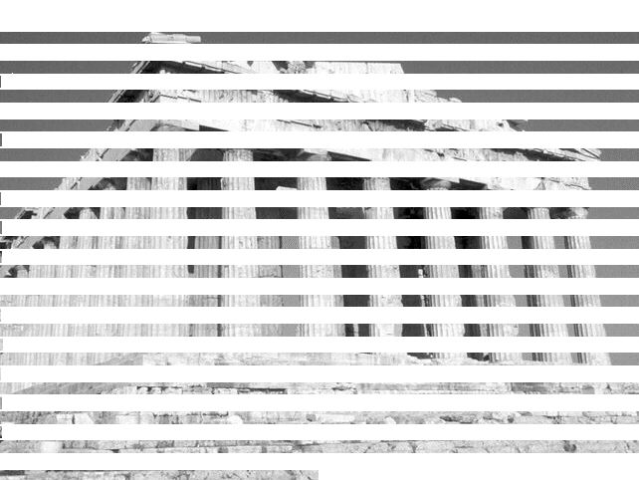
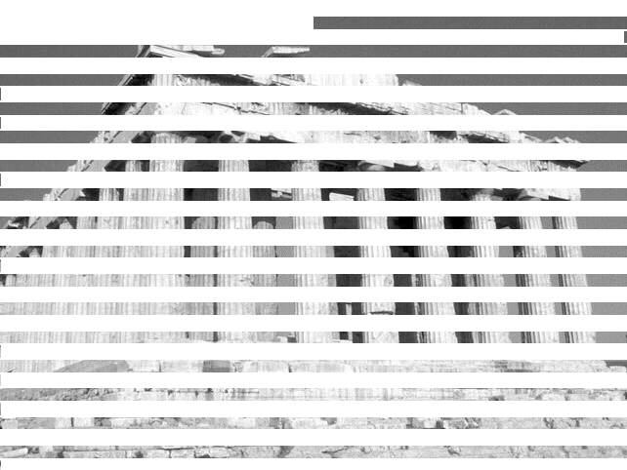
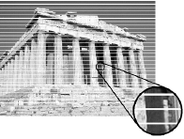
Interlaced Scanning
start field 1
start field 2
field 1 =
1/50th second
field 2 =
1/50th second
complete frame
= 1/25th second

Slide 30
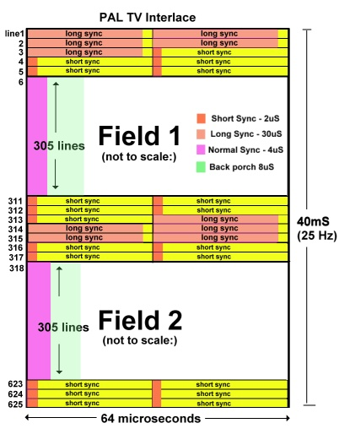
Interlaced Scanning
http://www.retroleum.co.uk/electronics-articles/pal-tv-timing-and-voltages/

Slide 31
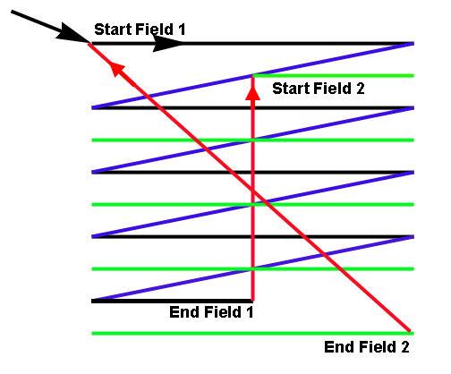
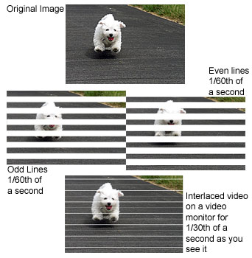
Frame Rate (In Analogue Days)
A Frame represents a complete TV picture
analog TV Frame consists of 625 lines.
Frame = 2 Fields each containing 1/2 the picture information
PAL system Frame rate = 25 Hz; Field rate is 50 Hz
NTSC … 30Hz; Field rate = 60Hz;
Pictures displayed at frame rate exhibit obvious flicker
Interleaving the Fields reduces flicker.
NTSC figures

Slide 32
Flicker and Judder
Flicker and Judder: visual interruptions between successive fields of a displayed image (affected both Film & TV).
If the update rate is too low, persistence of vision is unable to give illusion of continuous motion.
Flicker is caused by:
Slow update of motion Information
Refresh rate of the Display device
Phosphor persistence Vs Motion Blur
Judder usually results from Aliasing between Sampling rates, Display rates and Scene motion

Slide 33
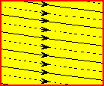
Interlace
To reduce the perceived screen flicker (25 Hz) on a television, a technique called 'interlacing‘ is employed.
Interlacing divides each video frame into two fields; the first field consists of the odd scan lines of the image, and the second field of each frame consists even scan lines.

Slide 34
Interlaced Vs Progressive Scan
Interlaced pictures. - 1/2 the lines presented each scan 1,3,5,7,9,11,13...............623,625 field 1 2,4,6,8,10,12,14.............622,624 field 2
Because the fields are recorded at separate times this leads to picture twitter & judder
Progressive pictures - all the lines sent in the one scan. 1,2,3,4,5,6,7,8................623,624,625 picture
No twitter or judder.
Notes:
The current interlace system uses 2 interleaved fields of lines to make up every picture. Differences between the temporal sampling of the two fields lead to effects such as twitter and judder on moving objects.
With progressive scanning adjacent lines come from adjacent temporal moments and so do not exhibit these effects.

Slide 35
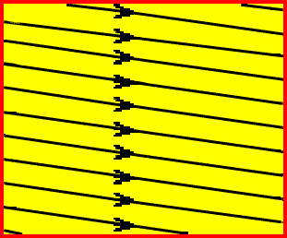
Progressive Scan
Simplifies the interpolation and filtering of images
Allows MPEG-2 compression to work more efficiently by processing complete pictures
Direct processing of progressively-scanned sources
24 frame/second progressive film mode can be provided.
Assists video conversions with different:
numbers of scan lines
numbers of samples per line
temporal sampling (i.e., picture rate)

Slide 36
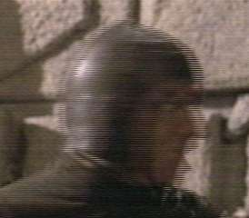
(De-) Interlaced Scanning
Problems –
… deinterlace required for progressive playouts - LCDs, LEDs, etc.,
... introduces lag between frames

Slide 37
Scan Line
TV
e.g. scan this image:
312 ½ lines for the first field of a 625 line scan

Slide 38
Scan Line - Brightness
TV
Voltage of signal denotes the required level of brightness in the image

Slide 39
Scan Line - Brightness
TV
... now add the line synchronisation at the start of the line

Slide 40
Scan Line - Brightness
TV
Scan line
white level
black level
blanking level
Horizontal blanking interval

Slide 41
Scan Line - Brightness
Line scan further down the screen
TV
Scan line
white level
black level
blanking level
Horizontal blanking interval

Slide 42
Scan Line Details
Horizontal Blanking
10.9μS
Active Video
52.6μS
Black Level
Blanking Level
63.5μS
Typical waveform of a TV signal
Blanking – when the beam reaches the end of a line, the must be blanked as the beam flies back to the start of the next line (i.e. so it is not visible on the screen
sync
tip
4.7μS
Back
Porch
1.6μS
colour
burst
2.5μS
Front
Porch
1.6μS
Breezeway 1.6μS

Slide 43
Several Lines Progressing Down The Screen...
A series of line scans for Field 1:
Line 1........2.......3.......4........5........6.......7........8........ 9 to 309 ...................310...311.....312...312½
The scanned lines have now reached the middle of the bottom of the screen
hence the half line at the end
Now they need a sync pulse to get the beam back to the top of the screen for Field 2

Slide 44
Vertical Sync – Return the Beam to the Top of the Screen
end of Field 1 ...............................start of Field 2
.........312½ .................. ½ ................................ to ..................................625
Vertical sync pulses – guide beam back to the middle of the top of the screen for Field 2

Slide 45
Scan Line Details
Horizontal Blanking
Active Video
63.5μS
Video signal is encoded and transmitted not as RBG, but as YCrCb
The signal contains
luminance signal (Y)
colour information – chrominance in terms of...
... (see next slide) ...
colour
burst

Slide 46
PAL Standard
Total Scan Lines = 625
Total Visible Lines = 576 – i.e. 49 lines (each frame) are invisible
Picture Frequency = 50 fields per second (50 Hz)
Line Frequency = 15625 Hz (625 lines x 50Hz / 2)
Frame Rate / Refresh Rate / Picture Rate = 25 frames per second
Total Bandwidth = 7 MHz + 1MHz guard band = 8MHz spacing
Colour Clock Cycles per line = 283.75 cycles
Colour Sub-Carrier (Chroma Carrier), f_{sc} = 4.43361875 MHz
Visible Line Bandwidth for the PAL (D) Standard = 6 MHz
Total Time each scan line = 64µs
Active Video each scan line = 52µs
Front Porch = 1.65µs (+ 0.4µs – 01µs), Sync Pulse = 4.7µs (± 0.20µs), Back Porch = 5.7µs (± 0.20µs)
Aspect Ratio = 4:3 (1.3333333)

Slide 47
“Visible Lines”
Vertical retrace is slow compared to horizontal trace (due to magnetic inertia of coils in the receiver)
The retrace takes the same time as 49 horizontal lines
History: it is the field governing the coils which control the beam which continues operating whilst the vertical retrace takes place
This takes the same time as the missing lines
… so only 576 lines carry video (PAL)
This time is utilised for the horizltal lines to carry additional information …
teletext
closed captioning
etc
576 VISIBLE LINES

Slide 48
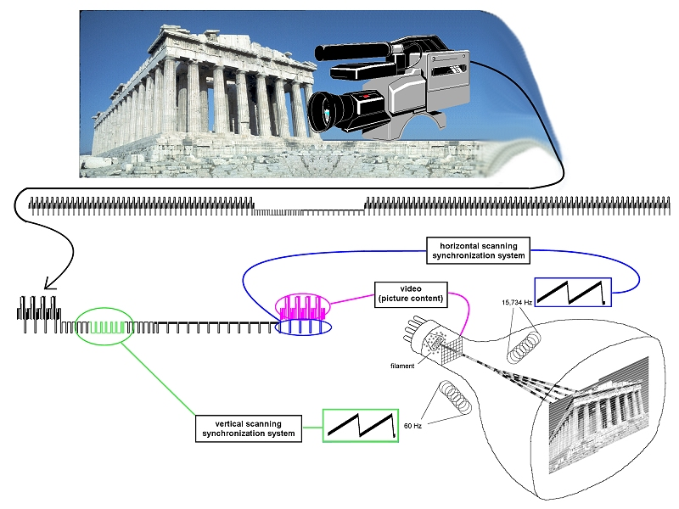
From Camera to Screen
http://www.danalee.ca/ttt/images/6/camera_and_monitor_big.jpg

Slide 49
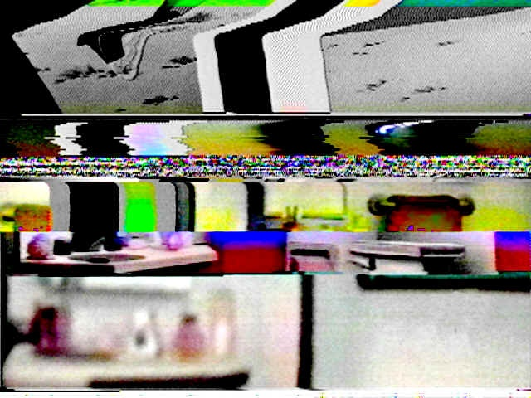
Analogue Pay-TV Scrambling (Historical interest only ...)
Scrambled video -
sync removed
i.e. subscribers were only paying for the horizontal sync signal!
However, modern systems (cable, satellite and IPTV) rely on more sophisticated methods
(CAS – Conditional Access Systems; later in module)
http://www.danalee.ca/ttt/analog_video.htm

Slide 50
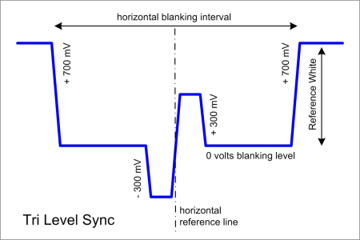
Tri Level Sync – Video Synchronisation, mainly for HD
Syncing devices together
Genlock (Generator lock)
traditionally black-burst (single –ve pulse)
vertical, horizontal, frame, and color synchronization.
HD environments – Tri sync prfered
timing jitter reduced (higher frequency)
pulses in both polarities
Used in HD facilities
equipment output HD-SDI video
where baseband video needs to be
mixed
switched
luma keyed with any other sources
… need to be synchronous
first pixel of first line transmitted at the same time
allows switcher to cut, mix or key sources together
… min delay (~1 HD video line
https://www.youtube.com/watch?v=qqmbrt17DjE

Slide 51
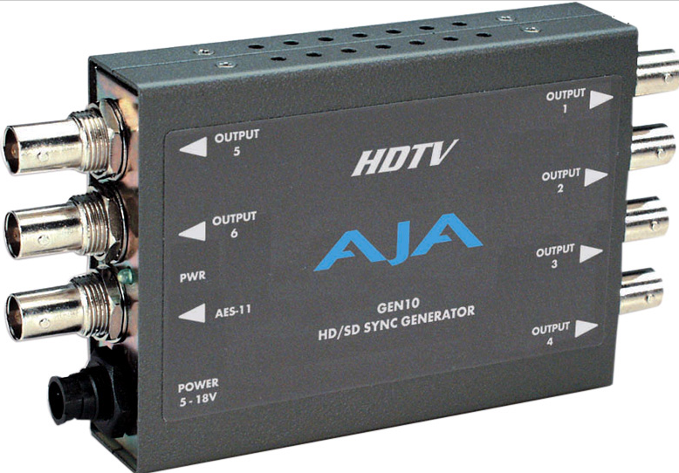
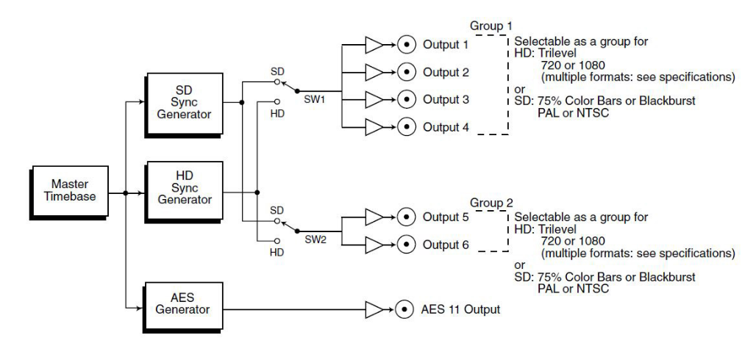
Tri Level Sync

Slide 52
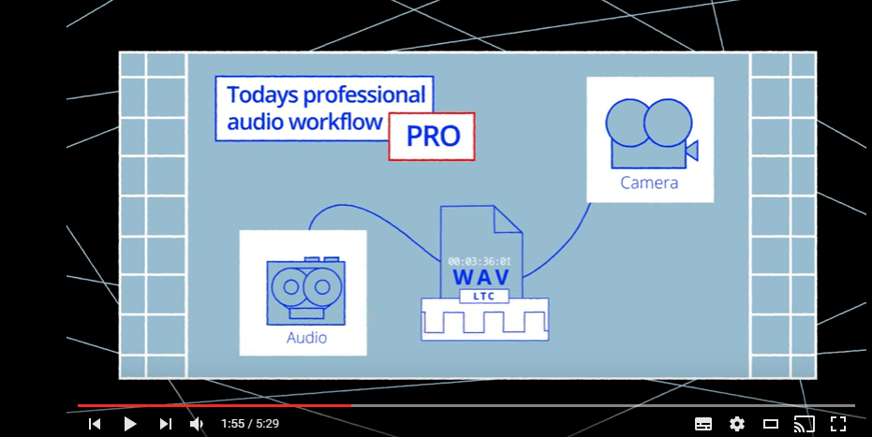
Timecode
HH:MM:SS:FF
plus drop codes for 29.97 (i.e. 30/1.001)
HH:MM:SS.FF
… more on this later in the course

Slide 53
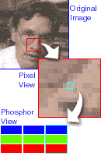

Resolution
The number of picture elements resolved on the display
Resolution in TV is limited by:
Capture device
Sampling Rate
Transmission System / Bandwidth
Display Device
Dot Pitch (LCD or plasma cells)
Focus & Convergence
Viewing distance / Display size
Human Eye

Slide 54
Refresh Rate
CRT is an instantaneous response
phosphors quick to light
dims after the beam has moved on down the screen
CRTs prone to flicker
high refresh rates (>70Hz) alieviate this
but TVs are limited to 25Hz frame rates
… higher rates achieved by doubling (i.e. repeating) frames
LCD – cells remains active until the next scan
this relies on a fast response by the LCD cells
slow refresh gives blurring on moving images
lower than 20mS required
10-15mS fairly common; down to 1- 3

Slide 55
Lines, Pixels, Dots, Scaling
CRT – scans 625 lines / frame (2 x 312.5 lines / field interlaced
… but only 576 are active video
LCD and Plasma have more dots / pixels than 625 lines
… so picture needs to be scaled to fit the particular screen
… “upscaling” – important specification
Analogue signals transmitted by 625 lines / line scan
Digital signals – captured at required resolution (or above and then scaled down)
Transmitted as a digital file/stream format at that resolution
“mapped” on to required screen resolution
either as full screen TV
or as video window in graphics-card / PC

Slide 56
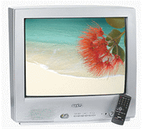
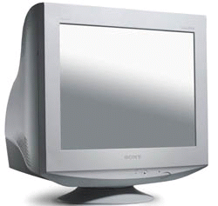
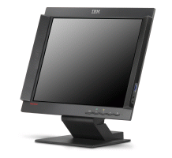
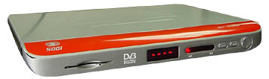
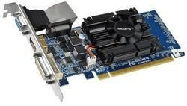
TVs, Monitors, Graphics Adapters
Broadcast TVs – assume standard line scan rates, frame rates, lines/frame, etc
Analogue TV Signal
Analogue TV Receiver
625 lines (PAL)
25 frames / sec interlaced fields
screen
PC’s – require higher resolution, higher refresh rates (less flicker)
handled by video card
LCD
CRT
LCD
Digital Signal - (MPEG, etc) off air, from DVD, or Hard Disk
Monitor
parameters – resolution, refresh - set on PC (graphics card)
... and modern TVs are monitors to STB, etc ...
Video card
eg PC (or Set Top Box)
receives (e.g.) MPEG info plus sync info;
knows monitor settings

Slide 57
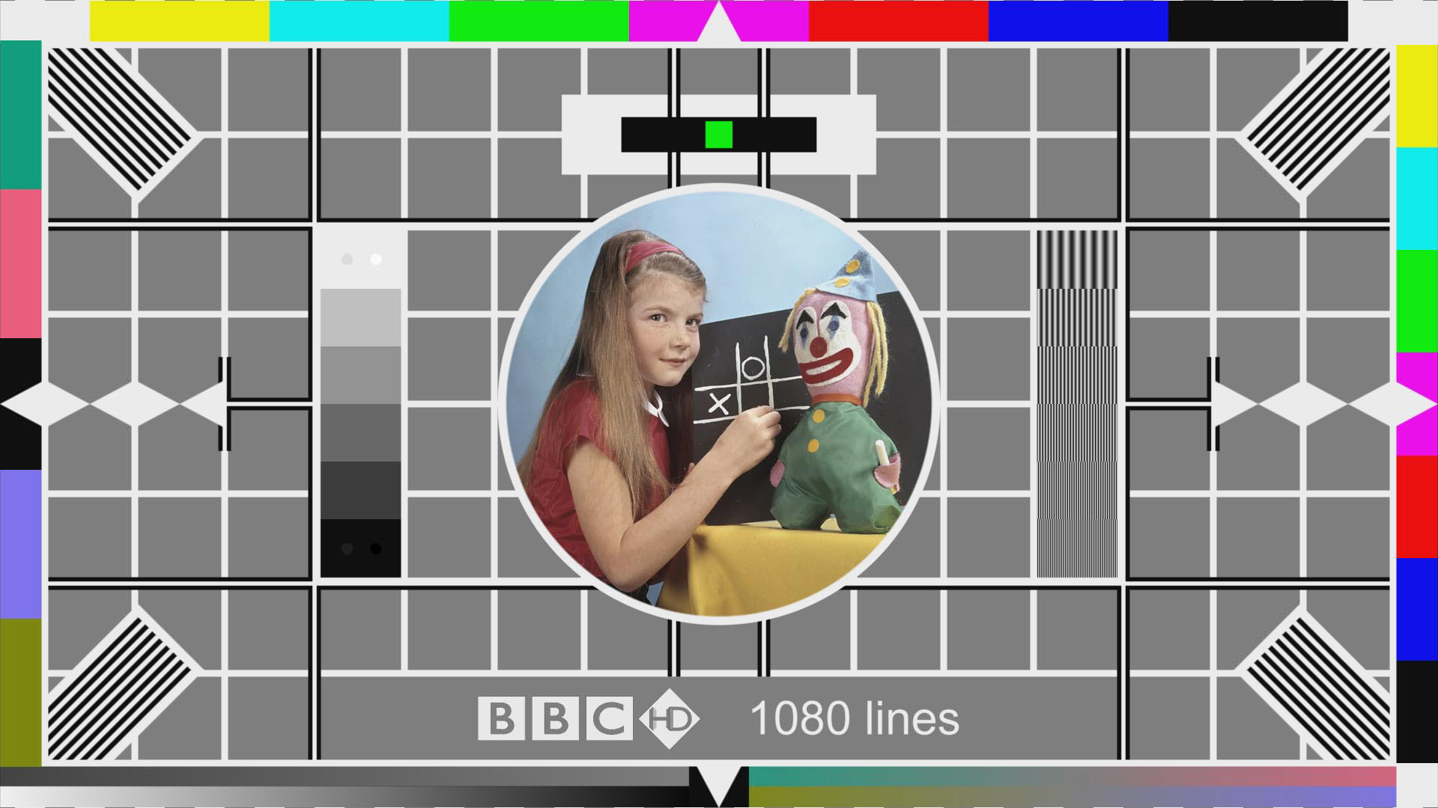

Slide 58
Colour

Slide 59

Colour – Requires 3 Beams – R, G, B
n.b. – these are all identical electron beams – not red, blue and green beams (!)
Red, Blue and Green Colour Guns
The beams have voltage values comensurate with the required red, blue or green image levels
They hit red, blue and green phosphor dots on the screen

Slide 60
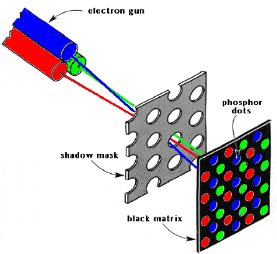
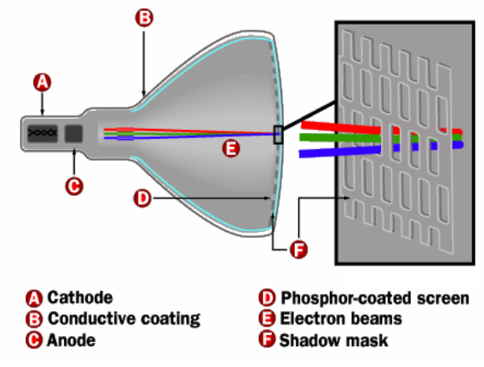
Colour Scanning via Shadowmask
Red Blue and Green colour guns scan image on to screen
... but need to be directed towards specific R, G or B phosphor dots on the screen
A shadowmask masks off the areas each beam should not cover
An alternative to the shadowmask is an aperture grille
similar function
allows flatter displays

Slide 61
Decoding Colour Information (analogue scans)
Horizontal Blanking
Active Video
colour
burst
Active Video section of the signal (above)
Y, Cr and Cb (analogue: Y, Pb,Pr) signals are modulated on to the signal carriers:
FM carriers + phase modulated carriers for colour (chrominance) information
Colour burst
gives information on synchronising the demodulation of the colour information from this part of the signal (on a per line basis)

Slide 62
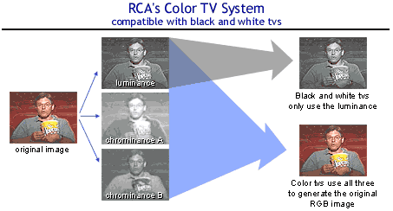
A Compatible Colour System
Y
Y
V
R G B
U
Now, digital …

Slide 63
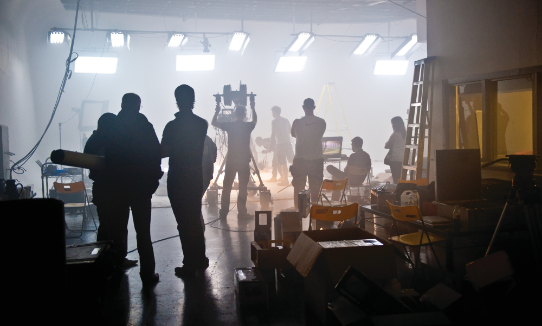
Image Comprises RGB
Original captured image at camera sensor:
Each pixel is represented by R, B, G
(each pixel has its own unique value)

Slide 64
Colour Space
Human Eye Perception
eye more sensitive to moving objects and edges rather than gradual transitions
… red / green / blue sensitivities
… more sensitive to changes in brightness (luminance)
… than colour (chroma)
Coding for Colour Information
… as colour spaces – luma+chroma
… typically encoded as Y,Cb,Cr
(c.f. Y,Pb,Pr, YUV, other variants for PAL, NTSC)

Slide 65
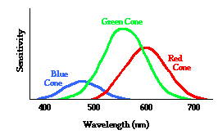
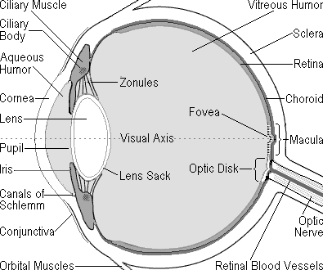
Psychovisual – how we perceive images
Light sensitivity in the eye
Rods - light intensity - not colour
~125 million across the retina
characteristics of high speed black & white film
Cones - colour - responsive in three wavebands
6 or 7 million cones
characteristics of low-speed colour film
RODS and CONES
(retina)
... Chroma Sub-sampling

Slide 66


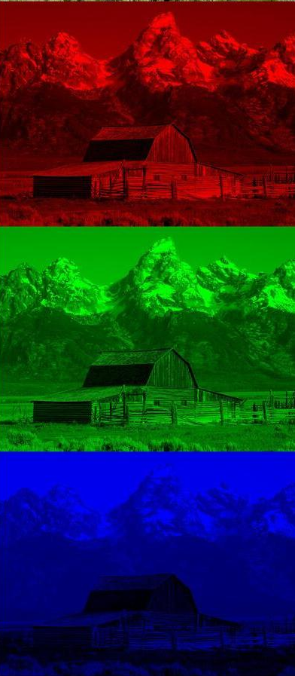


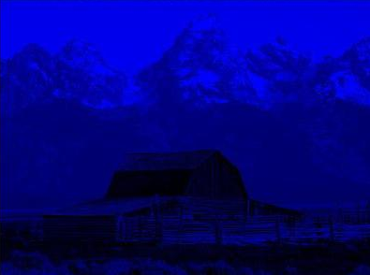

Colour Image using YCrCb
YCbCr elements of a colour image (digital codings)
Y
-
=
R
R
Y
Cr
-
=
G
B
Y
Cb
i.e. each pixel (RGB) → Y, Cb, Cr arithmetic
B

Slide 67
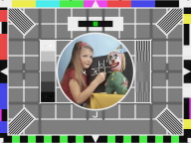
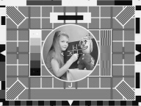






R, G, B and Colour Difference
Original colour
Colour Separation signals R, G, B
Luminance signal Y
Colour Difference signals R-Y, G-Y, B-Y

Slide 68







R, G, B and Colour Difference
Colour difference displays - (R-Y); (G-Y); (B-Y); (R-Y), (G-Y), (B-Y)
These show absence of the Y signal
When Y is added, displays are:
R G B RGB

Slide 69
Digital Representation
R’G’B’ and Y’CBCR
8 or 10 bits per sample in each color channel
8-bit encoding - R’, B’, G’, and Y’ channels range of 16..235
Cb, Cr channels = 16..240 (128 = neutral value)
R’G’B’
reference black = 16, 16, 16
reference white = 235, 235, 235
Y’CbCr
reference black = 16, 128, 128
reference white = 235, 128, 128
Values outside nominal ranges allowed, but usually clamped for broadcast
0 and 255 = timing references
10-bit encoding - 4x 8-bit encoding

